Slide 1


Anti bullying week presentation
© Copyright Family Lives 2023

Slide 2
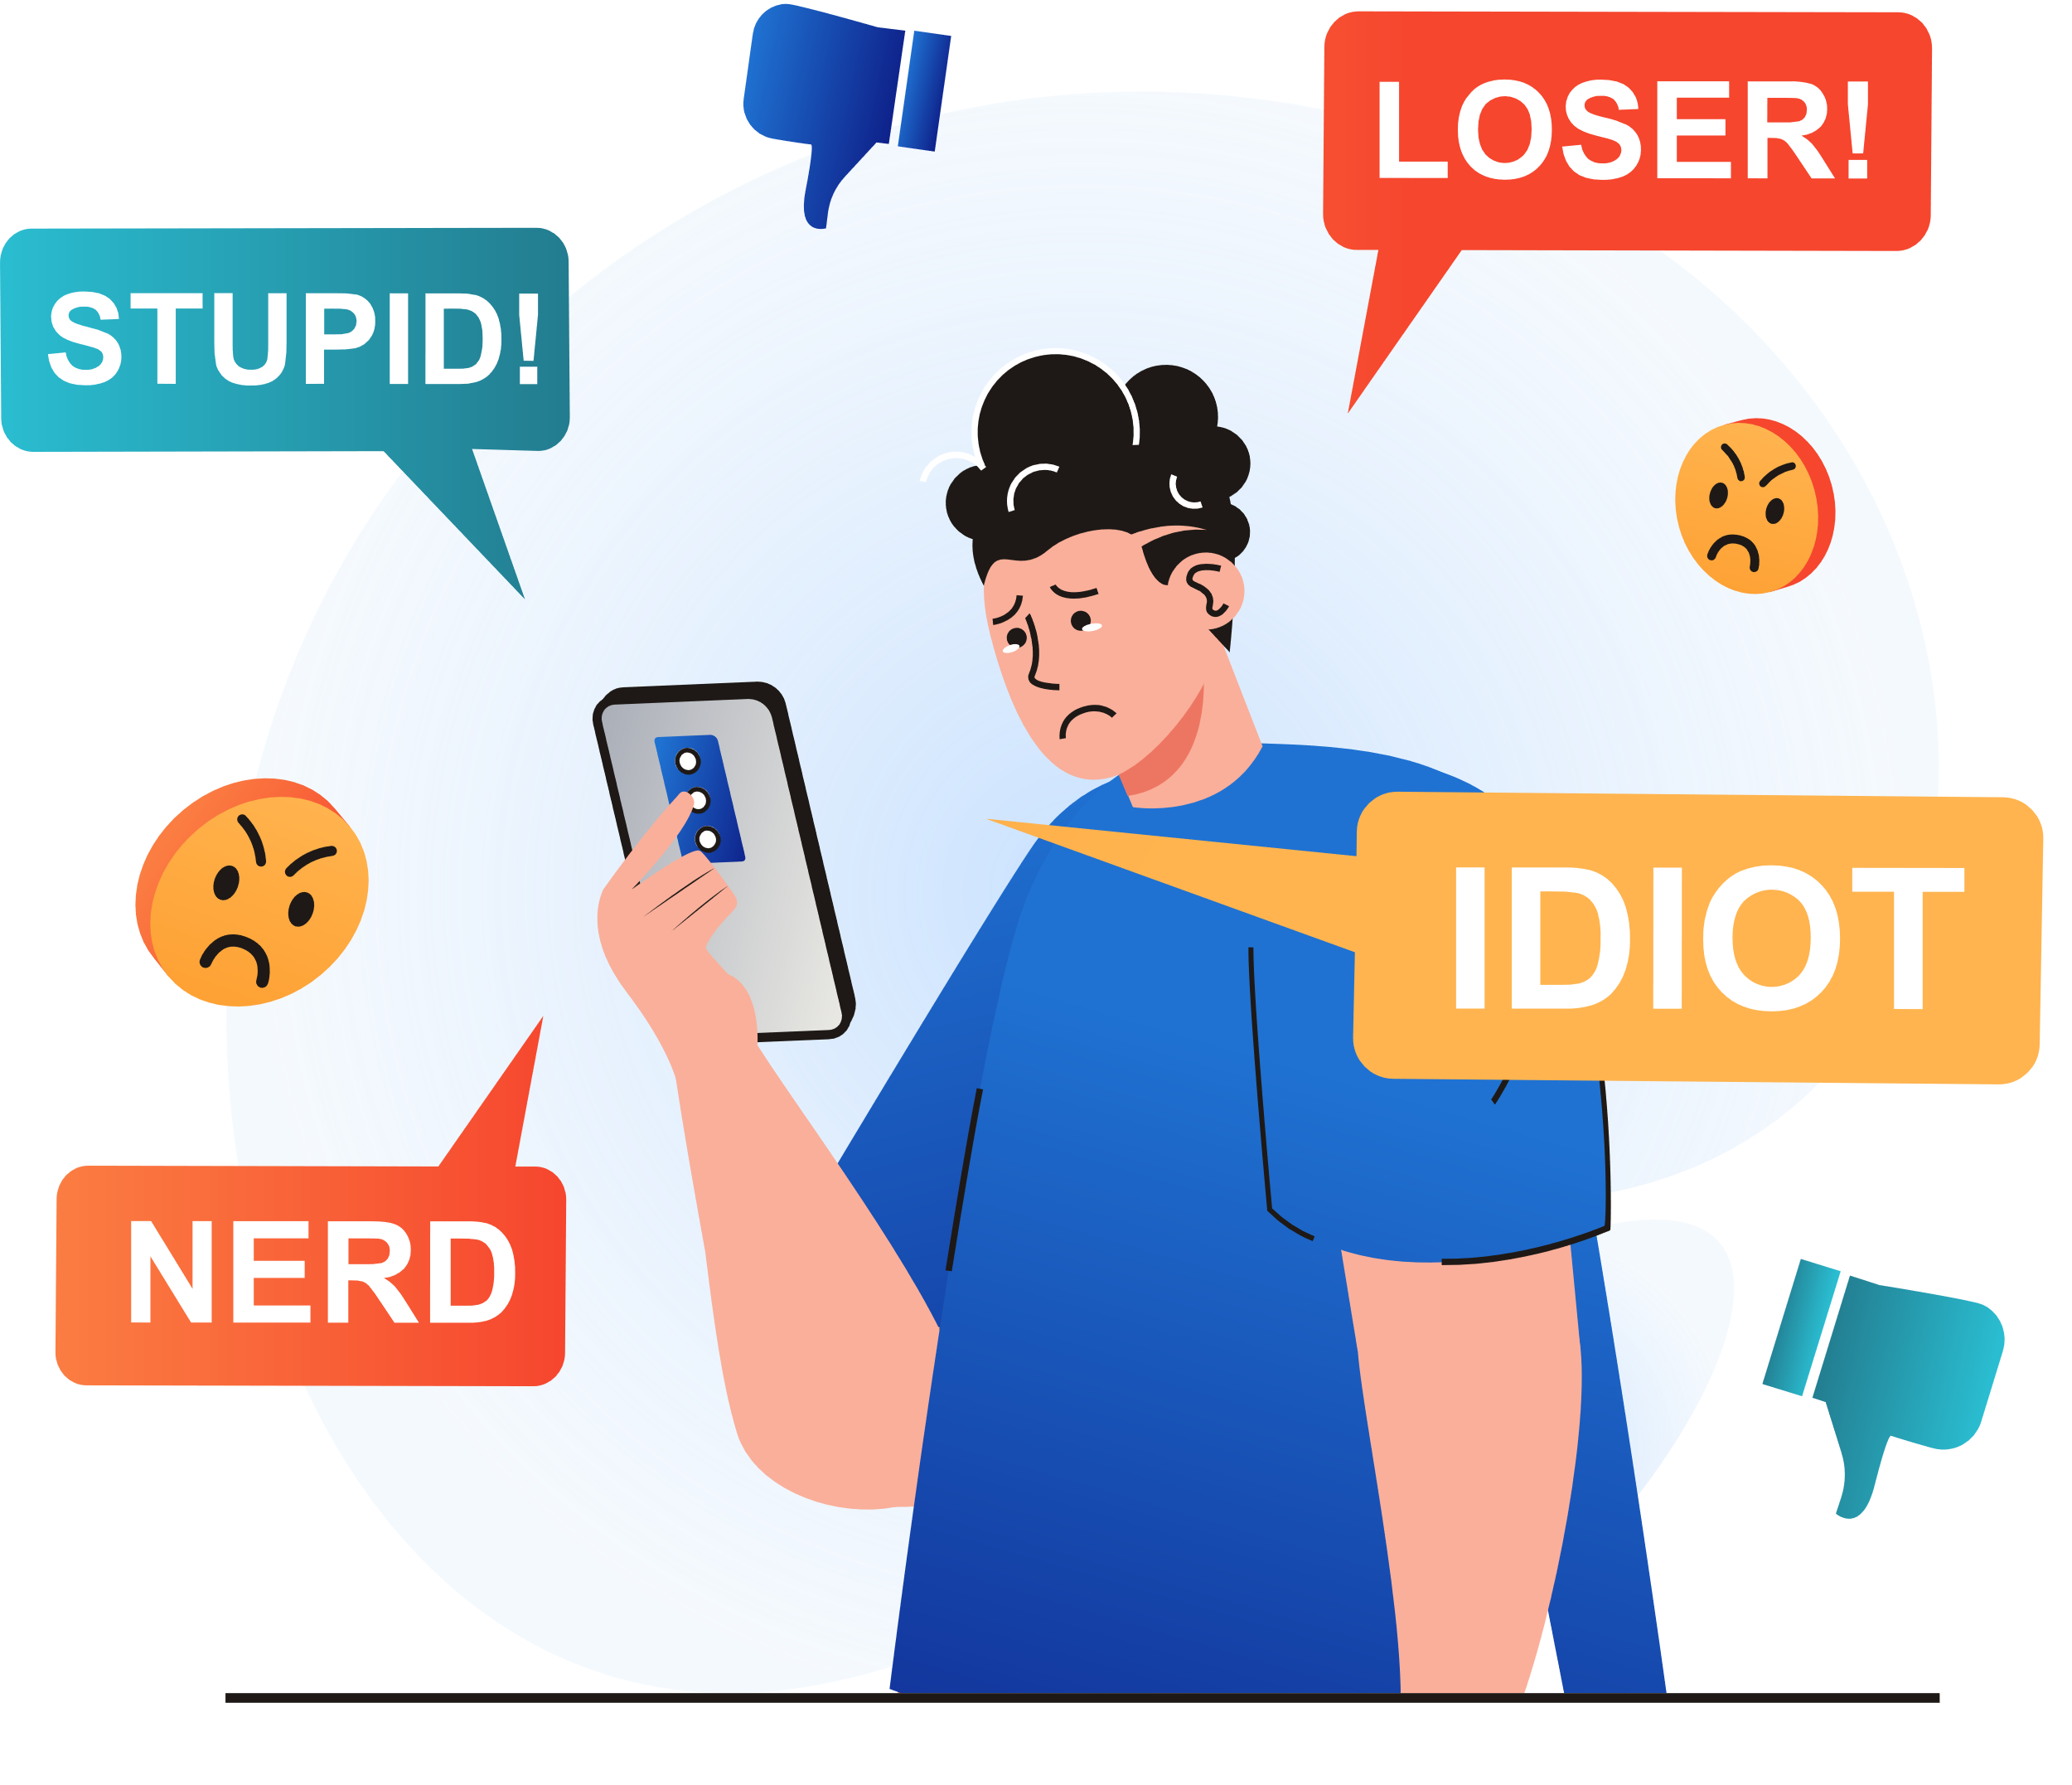
Bullying facts/stats
  69% of young people experience bullying before their 18th birthday.
  60% of people bullied because of appearance
  30% said that bullying has had a huge impact on their social lives
  38% said that bullying has had a huge impact on their self esteem
  25% young people have had suicidal thoughts because of bullying

Slide 3
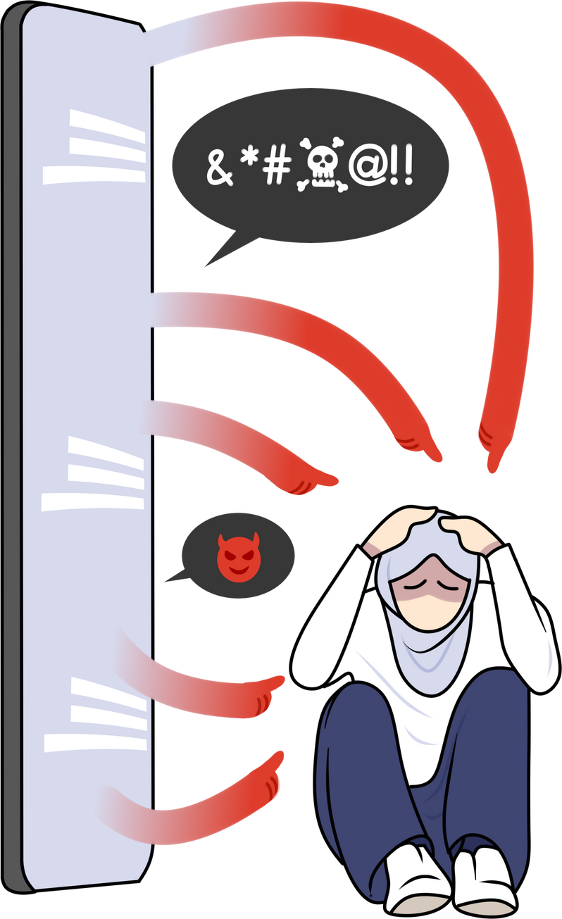
Types of bullying
  Physical (when someone pushes you, hits you or harms you in any way physically)
  Name calling (bullied by name calling regularly and it is hurtful)
  Social (leaving out, making plans and excluding others, etc.)
  Cyberbullying (being bullied online, via mobile phone or on social networks)
  Sexual (bullying includes unwanted sexual advances/comments, sexuality, spreading sexual rumours)

Slide 4
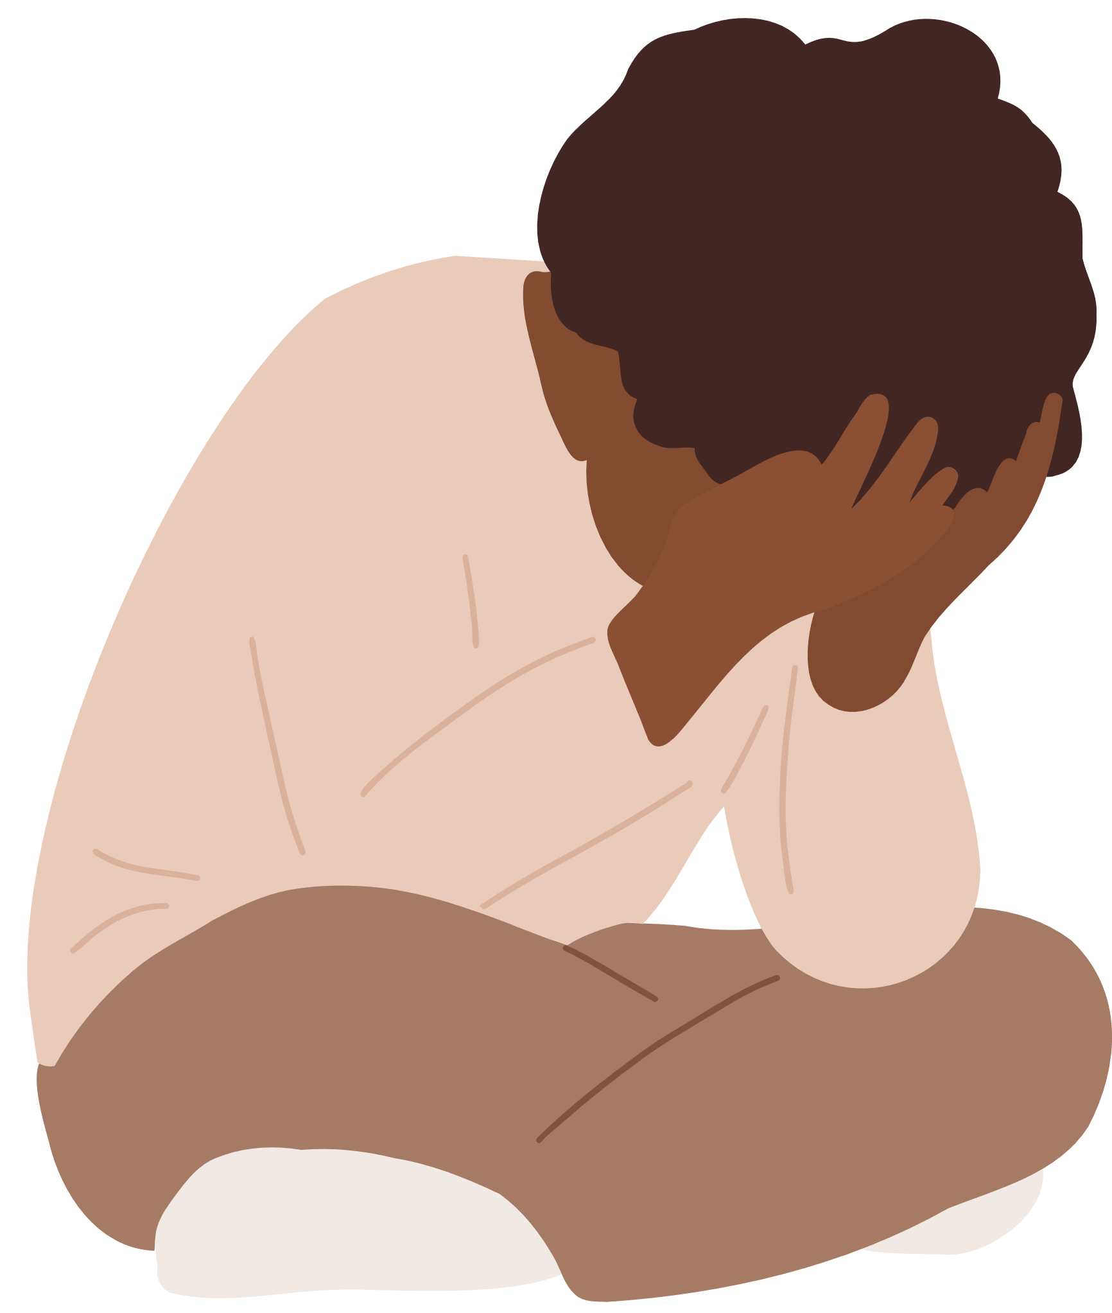
  Depressed
  Anxious
  Isolated
  Withdrawn
  Suicidal
  Humiliated
  Low
  Upset
  Angry
  Frustrated
  Start to believe it
  Blame themselves
How bullying can make you feel

Slide 5
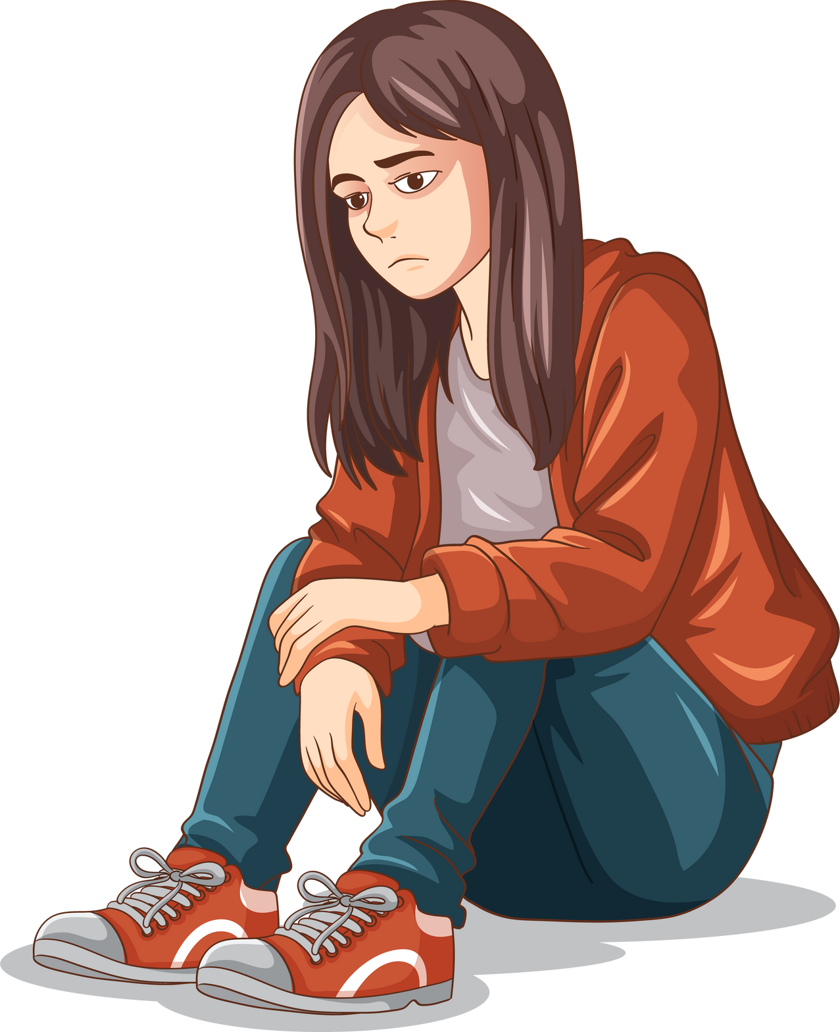
How might they react?
  Self-harm
  Feel depressed
  Suicidal thoughts/attempts of suicide
  Withdraw socially and stop going out
  Avoid social media or messenger
  Feel anxious about going to school
  Be very angry and be aggressive
  Bully others
  Develop an eating disorder
  Turn to drinking or taking drugs

Slide 6
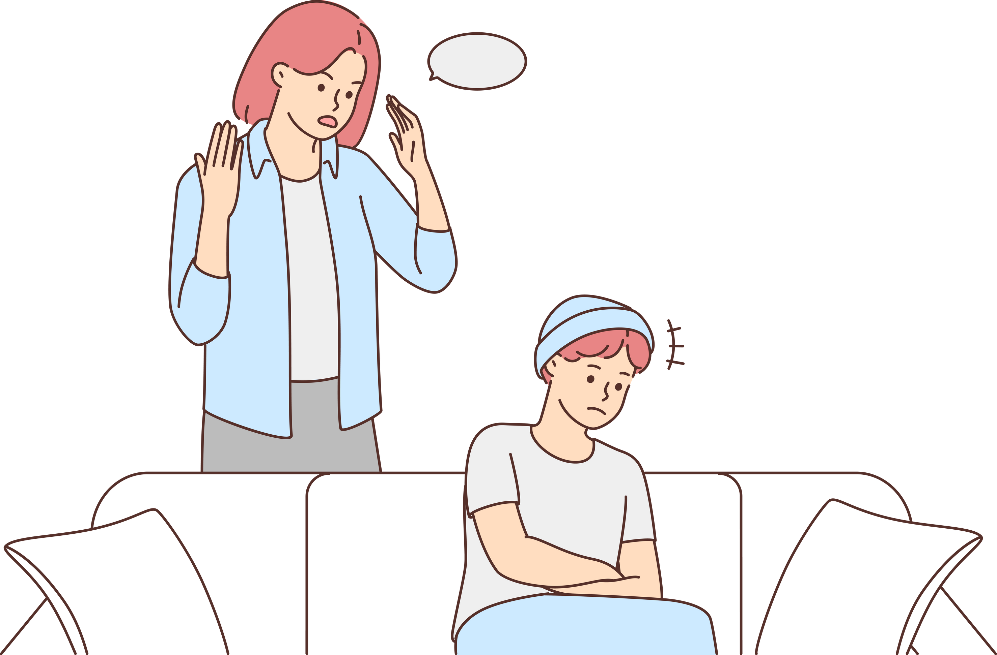
What about how bullying affects other areas of life?
  Family life
  School work
  Relationships
  Friendships
  Socially
  Mental health
  Future relationships

Slide 7

How to get bullying to stop
  Speak to a teacher
  Talk to a parent or a family member
  Be assertive
  Ignore it and walk away
  Keep a diary of all incidents
  Report it if it is online

Slide 8

True or false
  You can spot a bully from the way they look and act?
  Cyberbullying can only affect someone if they are online and have an account too
  Bullying is a normal part of childhood and you should just ignore it
  Bullying only happens in schools
  Reporting a bully will make things worse
  It is easy to spot the signs of bullying
  It is not bullying if someone deletes the comment or post

Slide 9
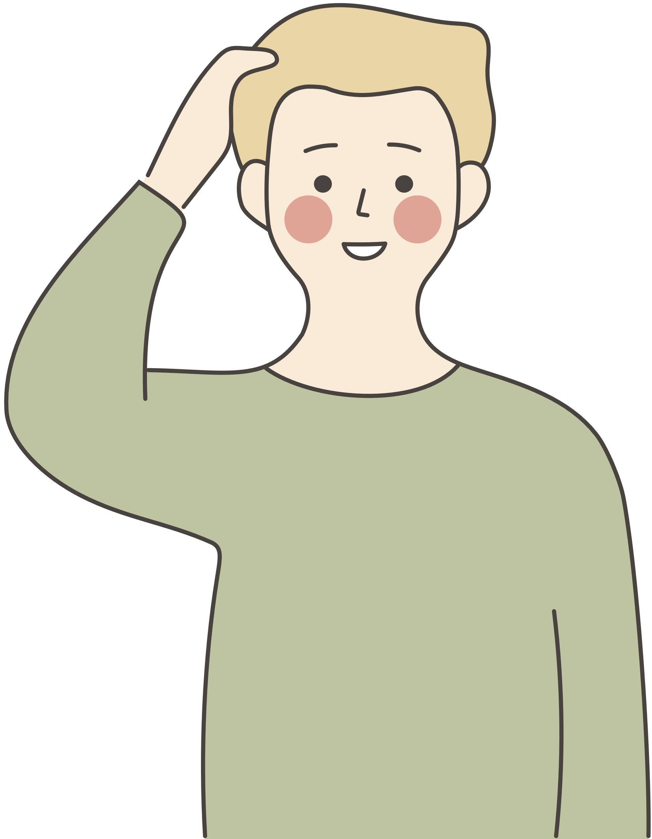
Bullying task one
Ask the students whose birthday is between January and July to stand up and remain standing. Ask them to put their hands on their hand. Then ask them how they would feel if they were asked to stand throughout the whole lesson. Once they describe their feelings (awkward, vulnerable, etc.) you reiterate to them that this is how people feel when they are being bullied even if they don’t show it.

Slide 10

Bullying task two
Give the students 2 pieces of paper and ask them to put one on the table and screw up the other one as tightly as they can. Once they have done this, ask them to unravel the screwed up piece of paper and try to straighten it out the best they can. Then ask the students to hold up the two pieces of paper and compare the differences. Then you can reiterate to them that no matter how much you try to straighten things out, the scars of bullying remain.

Slide 11

Notes:
Link to video: https://www.youtube.com/watch?v=-IraaalaNIg&list=PLe5gquxpB35pEPmazmUejiwkBgFjW9vaw&index=12

Slide 12









Free helpline: 0808 800 2222 (9am-9pm)
Website: www.familylives.org.uk
Email: askus@familylives.org.uk
Live chat: via website (Mon-Fri 10.30am – 9pm)
@BULLYINGUK
© Copyright Family Lives 2023

